Slide 1
Unit 5 Chapter 9
Hashing Techniques

Slide 2
Introduction
Calculating physical address of the records by using their key values
It is a searching techniques
4 types
Mid square method
Division remainder method
Folding method
Shifting method

Slide 3
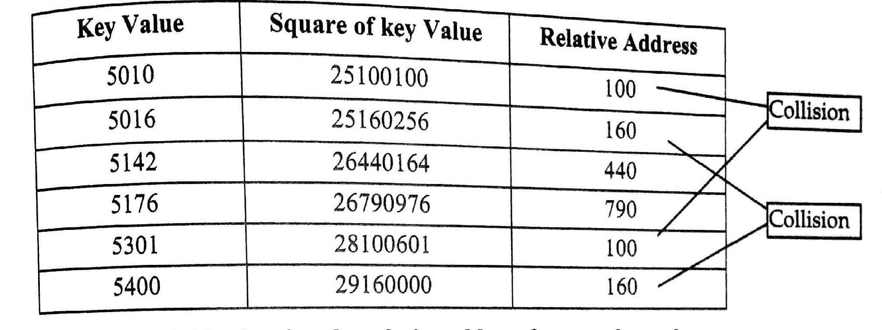
Mid square method

Slide 4
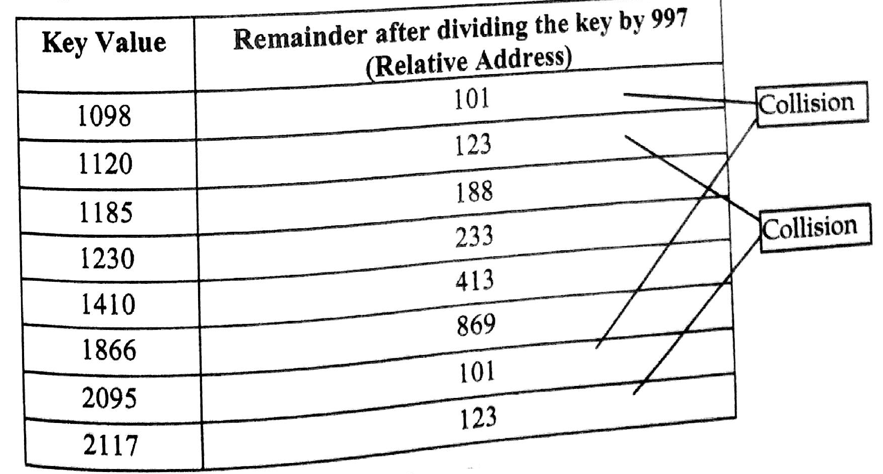
Division Remainder Method

Slide 5
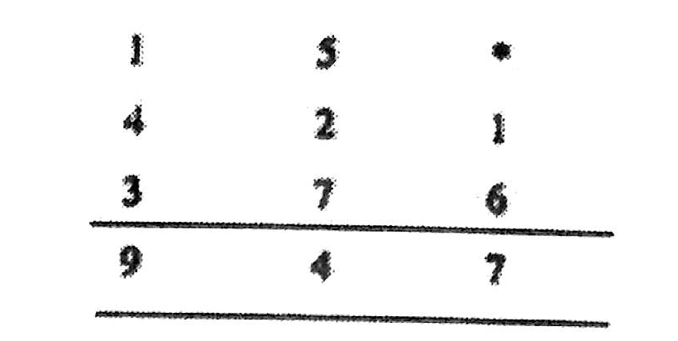
Folding Method
If the number is 51421673

Slide 6
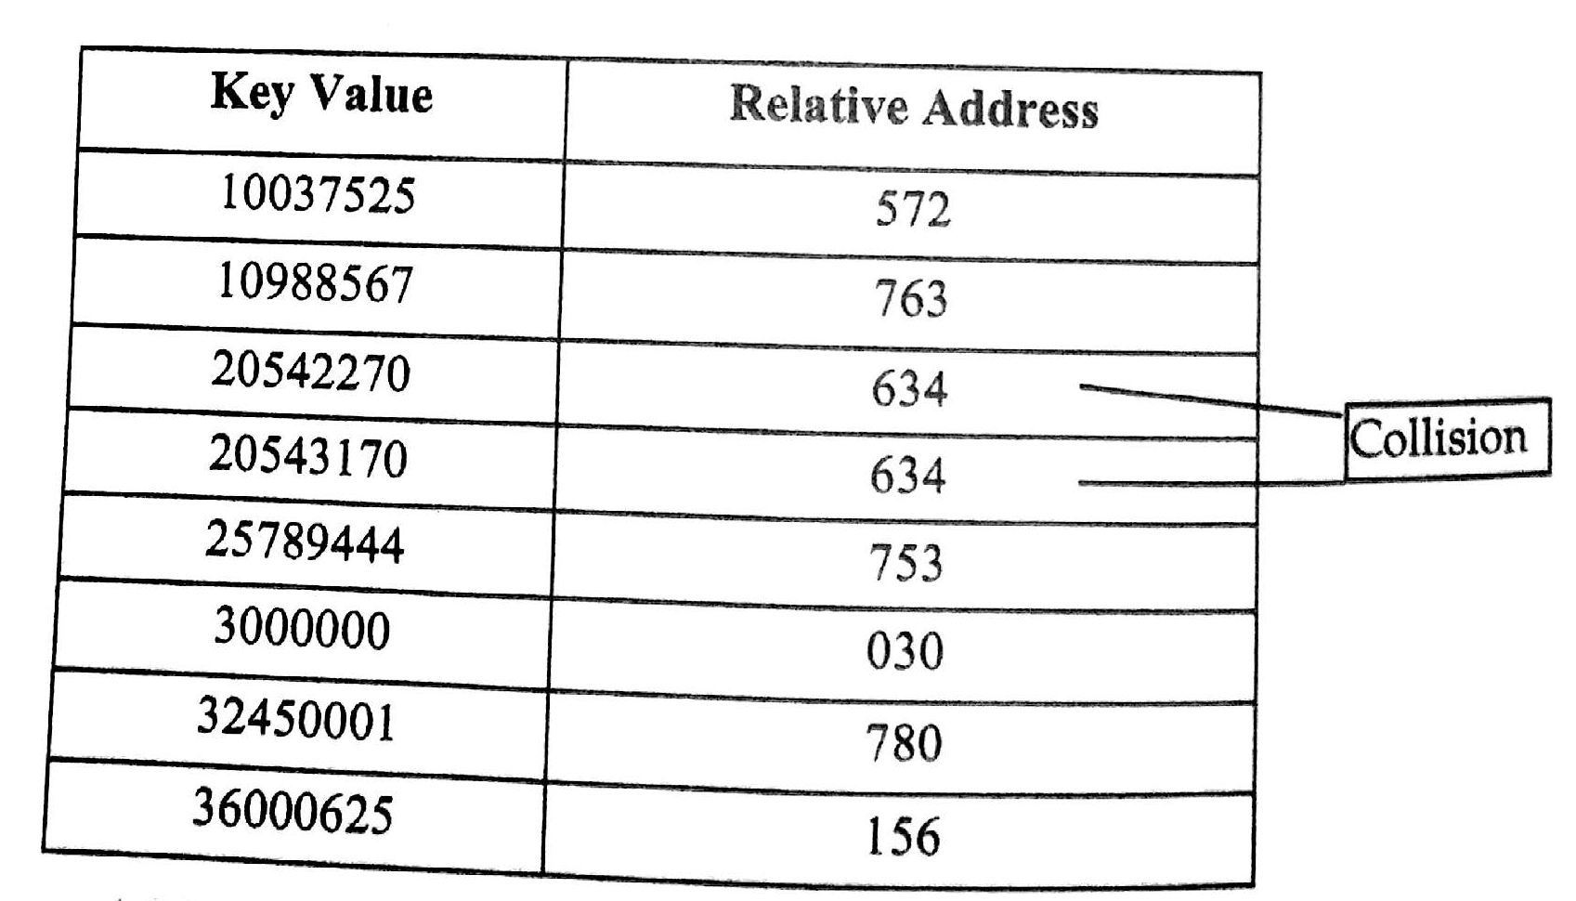

Slide 7
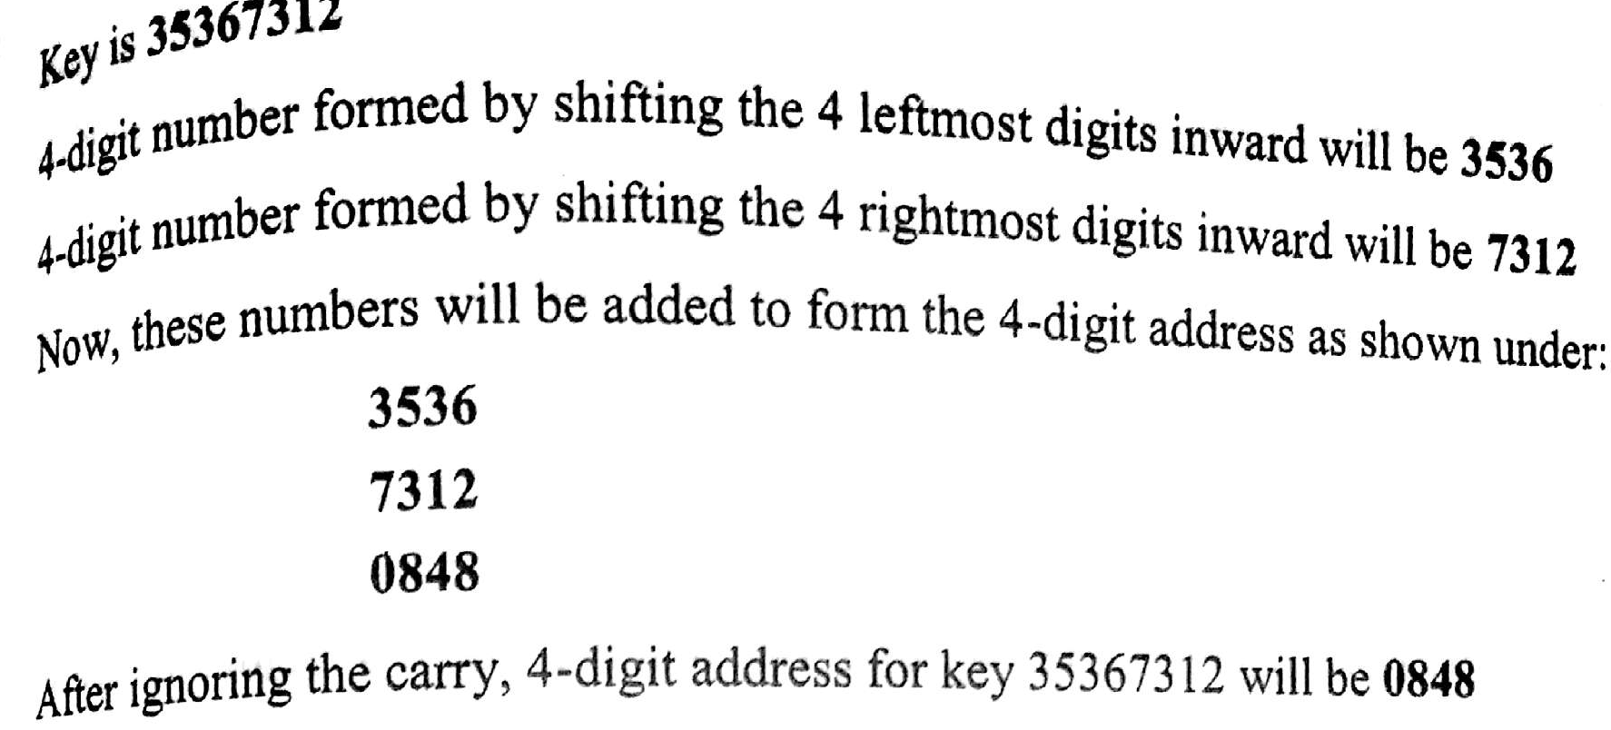
Shifting Method

Slide 8
Collision Resolution
Two records generating same address value.. Collision
2 techniques
Open Addressing
Chaining

Slide 9
Open Addressing
Key is mapped to some other vacant address in file
Finding free slots is called probing or open addressing
Linear Probing
E.g. P = (1 + P) mod TABLE_SIZE if collision
Quadratic Probing
E.g. h(K) + i²) mod M if collision
Double Hashing
E.g. h(x) = x mod 11, h2(x) = x mod 7 + 1

Slide 10
Bucket hashing

